Slide 1



MEDISHIFT -ALIGN
MediShift-Align
Smart Scheduling Seamless Care.
PRESENTATION 2025
https://devpost.com/software/medishift-align

Slide 2


agenda
About Us
History
Our Vision
Our Mission
Features
Facilities
Our Team
Time Line
https://devpost.com/software/medishift-align

Slide 3
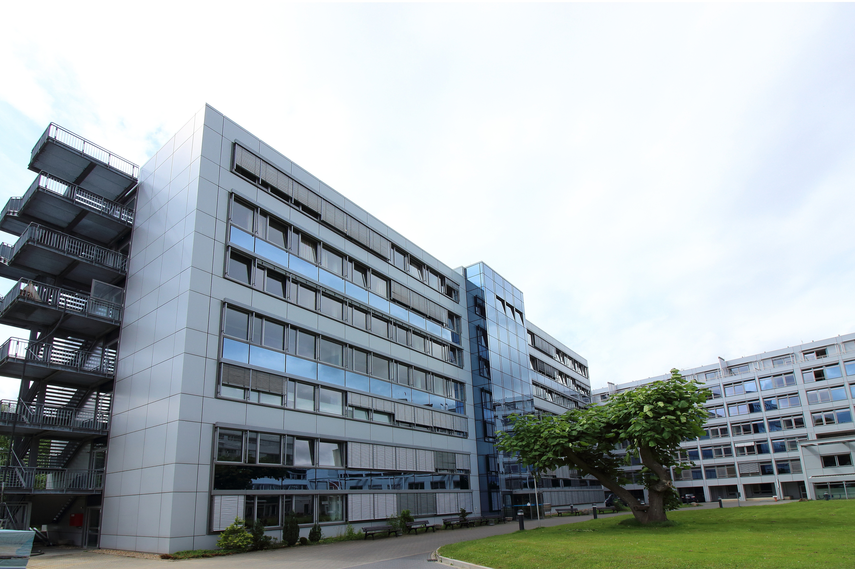
About Us
MediShift Align is a healthcare management platform designed to revolutionize shift scheduling and optimize hospital workflows.
Our mission is to empower healthcare professionals by reducing administrative burdens and focusing on patient care.

Slide 4

History
Founded to address challenges faced by hospitals in managing staff shifts and resources effectively.
The development journey began with identifying gaps in healthcare operations and creating technology-driven solutions.
Two weeks timeline to prototype and build an MVP (Minimum Viable Product).

Slide 5


Our Vision
Empower healthcare professionals by automating shift management and enhancing operational efficiency.
Bridge the gap between technology and healthcare for better patient outcomes.
Build a user-friendly system accessible to both small clinics and large hospitals.

Slide 6



Our Mission
Empowering Healthcare Through Technology
Automate shift management to enhance operational efficiency and allow healthcare professionals to focus on delivering quality patient care.
Building Accessible, Innovative Systems
Develop user-friendly solutions that bridge technology and healthcare, catering to the needs of both small clinics and large hospitals.

Slide 7


Features
MediShift-Align simplifies and enhances shift management through the following features:
Dynamic Staff Management
Patient & Room Allocation
Intelligent Scheduling
Create and manage roles for doctors, nurses, and support staff.
Optimize assignments for smooth operations.
Real-time clash detection and conflict resolution.
01
02
03

Slide 8
Features
MediShift-Align simplifies and enhances shift management through the following features:
Staff Portal
Admin Controls
Bidding System
View shifts, clock in/out, and track progress.
Update, delete, and manage records efficiently.
Ensure coverage for unfilled shifts with a fair bidding process.
04
05
06

Slide 9


Facilities
Web-based portal for admins and staff.
Real-time updates and conflict resolution.
Comprehensive dashboards for tracking performance and shifts.
Scalable architecture for handling large datasets.

Slide 10
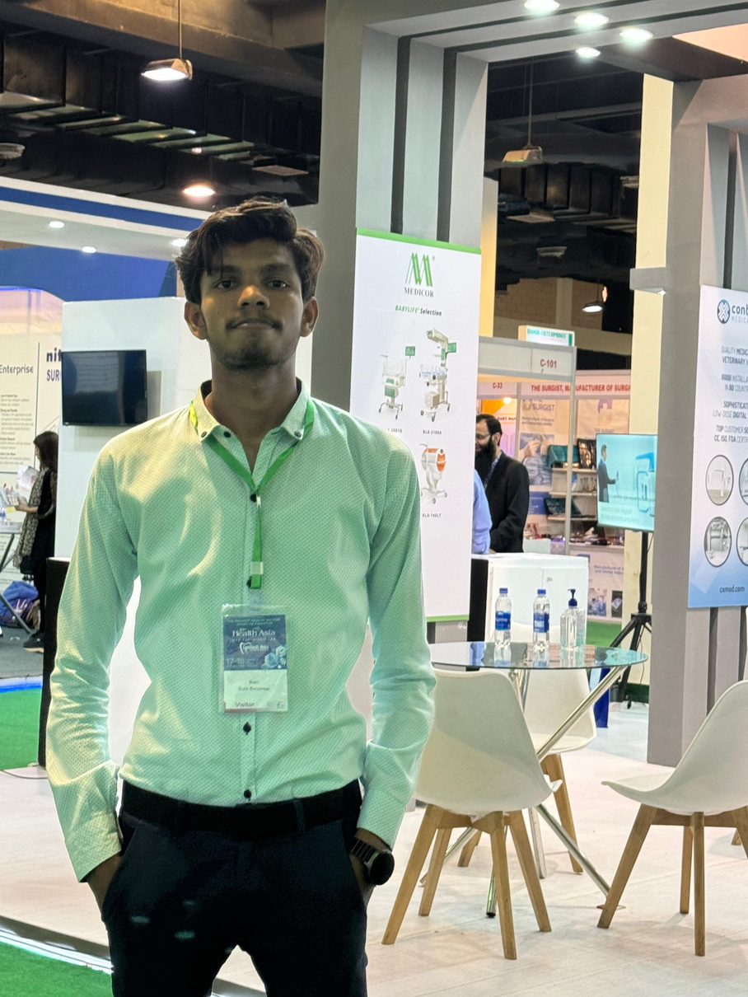



Our Team
Meet the healing hearts and brilliant minds behind our Project excellence.
SUMIT SHARMA
MUHAMMAD UZAIR
ABDULLAH
YASIR
Front-end Developer
MERN Stack Developer
UI/UX
Testing Expert
https://github.com/MuhammadUzair88/Hackathon-MediShift-Align

Slide 11


Time Line
Week 1: Research, Planning, and UI/UX Design
Conduct thorough research, plan project requirements, and design an intuitive UI/UX for the platform.
Week 2: Backend Development and Integration
Develop backend functionalities, integrate APIs, and perform final testing to ensure seamless performance.
Milestone: Prototype Delivery
Deliver a functional prototype at the end of two weeks, following an incremental development approach.

Slide 12
Thank
You

